Slide 1
Transformed objects
Transformations

Slide 2
how to use Oak lessons

Slide 3
I can identify whether a shape has been transformed or not.

Slide 4
A transformation is a process that may change the size, orientation or position of a shape.
If one shape can fit exactly on top of another using rotation, reflection or translation, then the shapes are congruent.
A property of a shape is invariant if that property has not changed after the shape is transformed.

Slide 5

Transformed objects
Which transformation?
Recognising and describing transformations

Slide 6
Which transformation?
Transformations change one or more properties of the object.
The key properties are lengths, angles, position, orientation and sense.

Slide 7
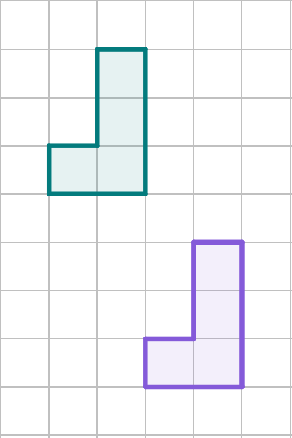
Which transformation?
Translation
Property | Changed - yes/no?
Orientation
Lengths
Position
Angles
Sense
No
No
Yes
No
No

Slide 8
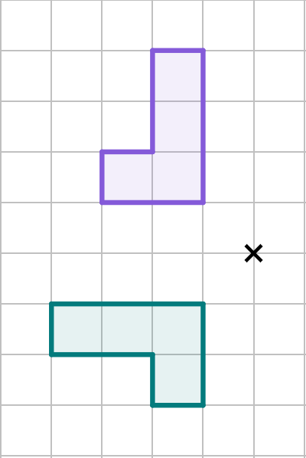
Which transformation?
Rotation
Property | Changed - yes/no?
Orientation
Lengths
Position
Angles
Sense
Yes
No
Yes
No
No

Slide 9
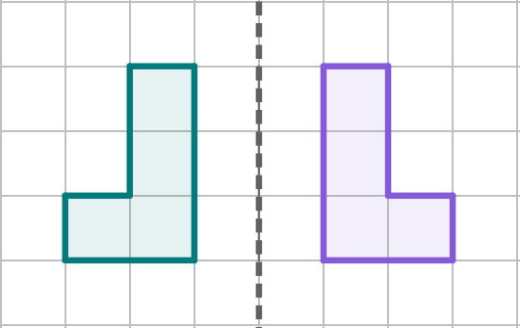
Which transformation?
Reflection
Property | Changed - yes/no?
Orientation
Lengths
Position
Angles
Sense
Yes
No
Yes
No
Yes

Slide 10
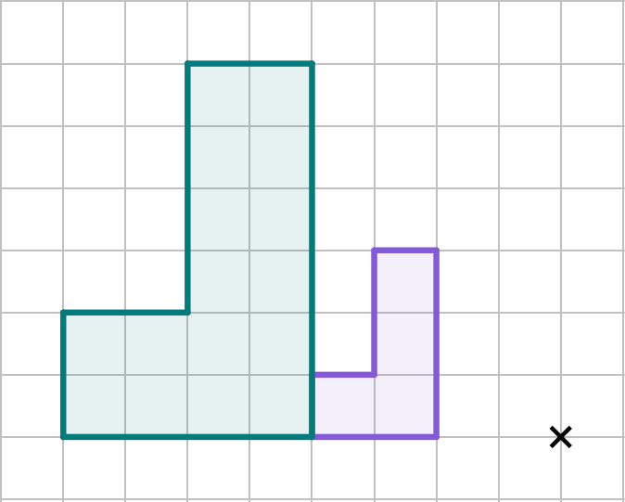
Which transformation?
Enlargement
Property | Changed - yes/no?
Orientation
Lengths
Position
Angles
Sense
No
Yes
Yes
No
No

Slide 11
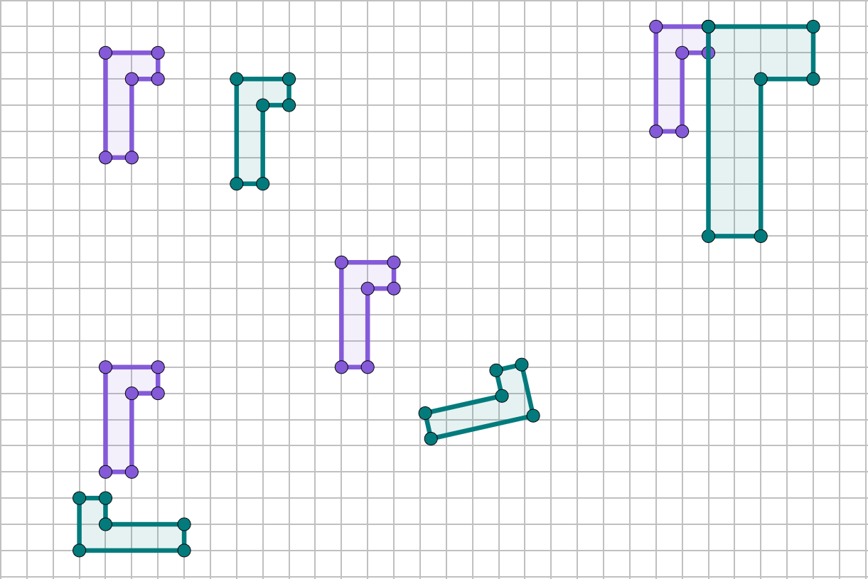



Which transformation?
One of the figures below, has been selected by Aisha. By asking a series of questions her friends are going to find which one.
Figure 1
Figure 2
Figure 3
Figure 4
A
D
A′
B
B′
C
Is the image congruent to the object?
D′
C′
Yes it is.
Andeep
Aisha

Slide 12
Which transformation?
Figure 1
Figure 2
Figure 4
A
D
A′
B
B′
D′
Has the orientation changed?
Yes it has.
Andeep
Aisha

Slide 13
Which transformation?
Figure 2
Figure 4
D
B
B′
D′
Has its sense changed?
No.
Andeep
Aisha

Slide 14
Which transformation?
Figure 4
D
D′
You selected figure 4!
Well done!
Andeep
Aisha

Slide 15
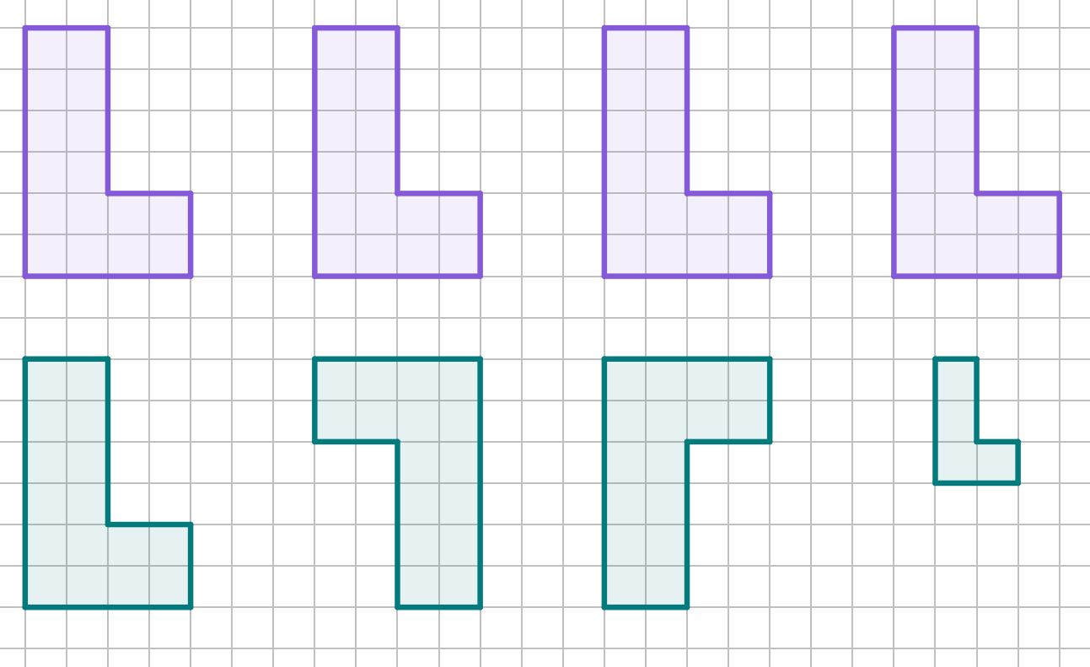




Which transformation?
Is the image congruent to the object?
No it is not.
a
b
c
d

Slide 16
Which transformation?
sense
reflection
As the has changed, a may have taken place.

Slide 17
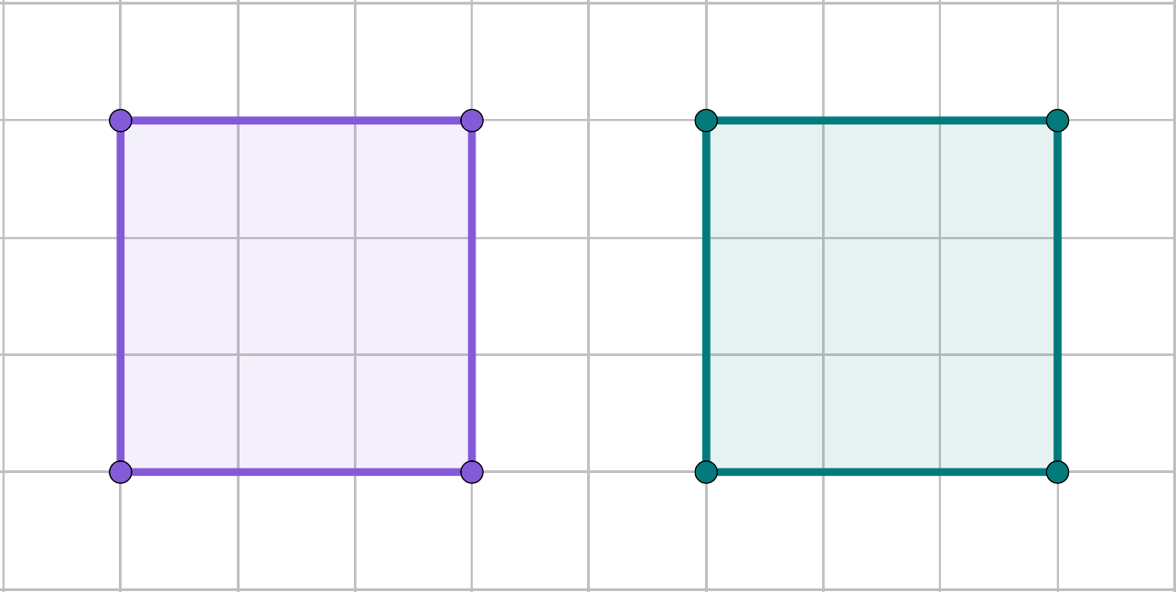
Which transformation?
The square could have been transformed in various ways.
A
D
A′
D′
B
C
B′
C′
It could have been a translation.

Slide 18
Which transformation?
The square could have been transformed in various ways.
A
D
D′
A′
B
C
C′
B′
It could have been a reflection.

Slide 19
Which transformation?
The square could have been transformed in various ways.
A
D
B′
A′
B
C
C′
D′
It could have been a rotation.

Slide 20
Which transformation?
The vertices of the image are always in the same position regardless of the transformation.
Each transformation causes a different effect on the image and therefore its vertices may change position.
The image is congruent or similar to the object.

Slide 21
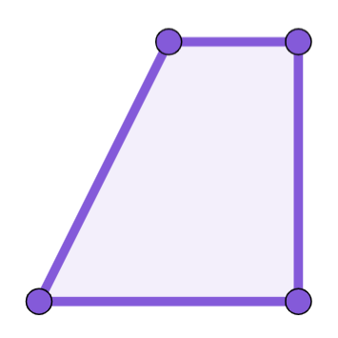
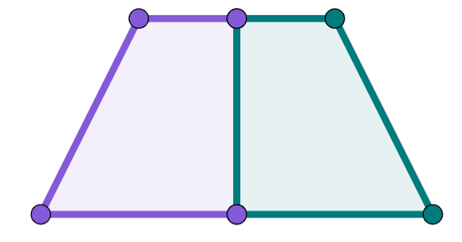
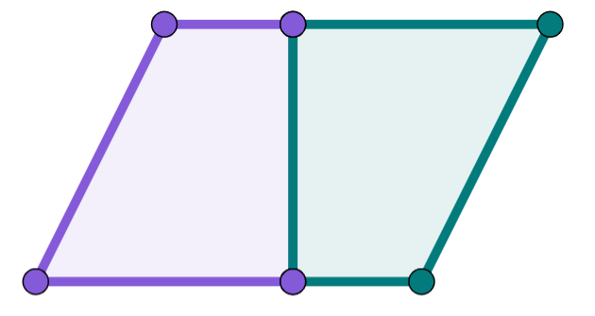
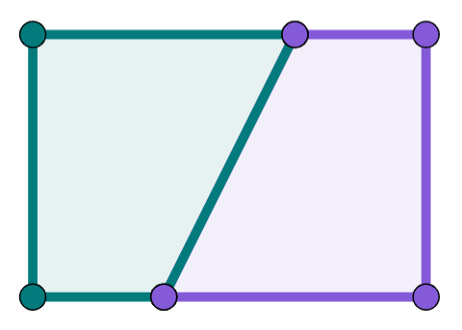

Which transformation?
This trapezium, along with its image, can create these three shapes. Which type of transformation has taken place?
x
x
A rotation.
A reflection.
A rotation.

Slide 22
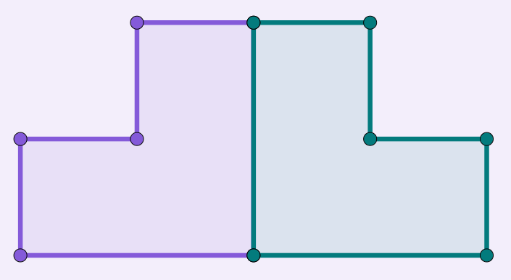
Which transformation?
Which transformation could not have taken place to create this shape, using the object and image.
translation
rotation
reflection

Slide 23
Which transformation?
By considering the changes, decide which transformation could have taken place in each case. There might be more than one.
the lengths have changed
the sense has changed
the orientation has changed
the position has changed

Slide 24
Which transformation?
By considering the invariant properties, decide which transformation could not have taken place in each case. There might be more than one.
the lengths are invariant
the sense is invariant
the orientation is invariant
the angles are invariant

Slide 25
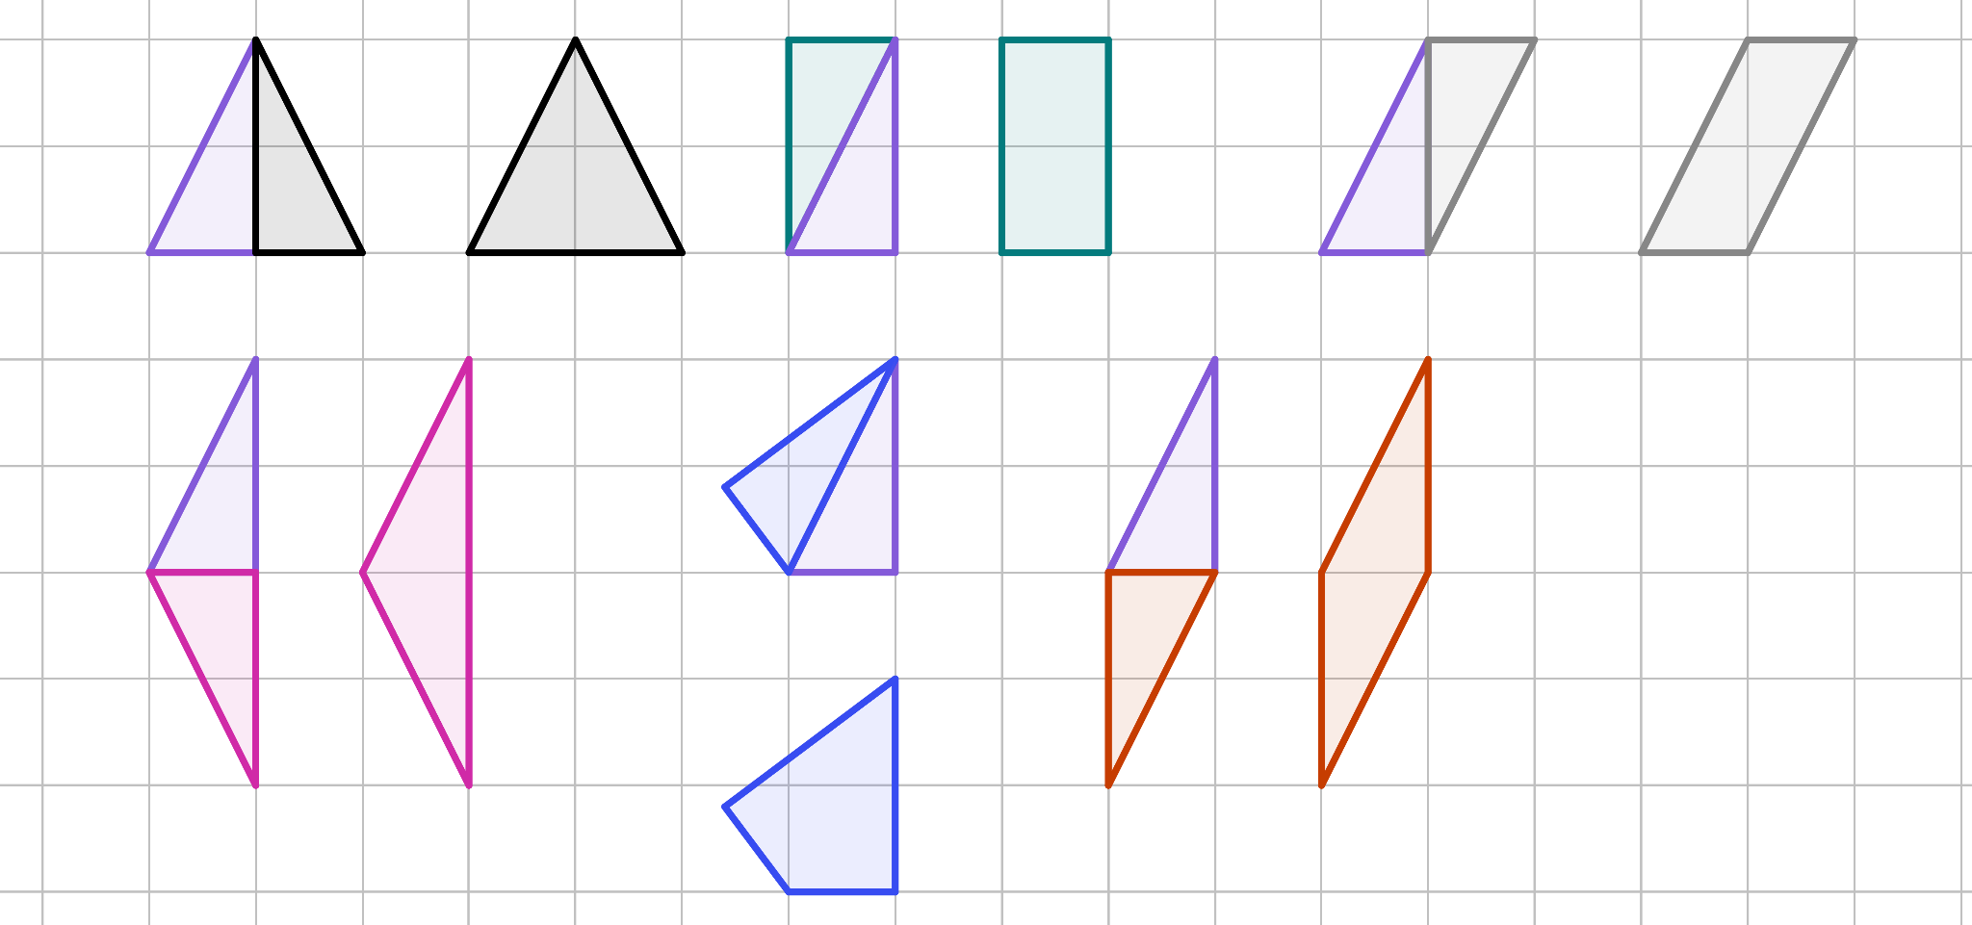
Which transformation?
Identify the type of transformation that has taken place to create the new shape.
a)
b)
c)
d)
e)
f)

Slide 26
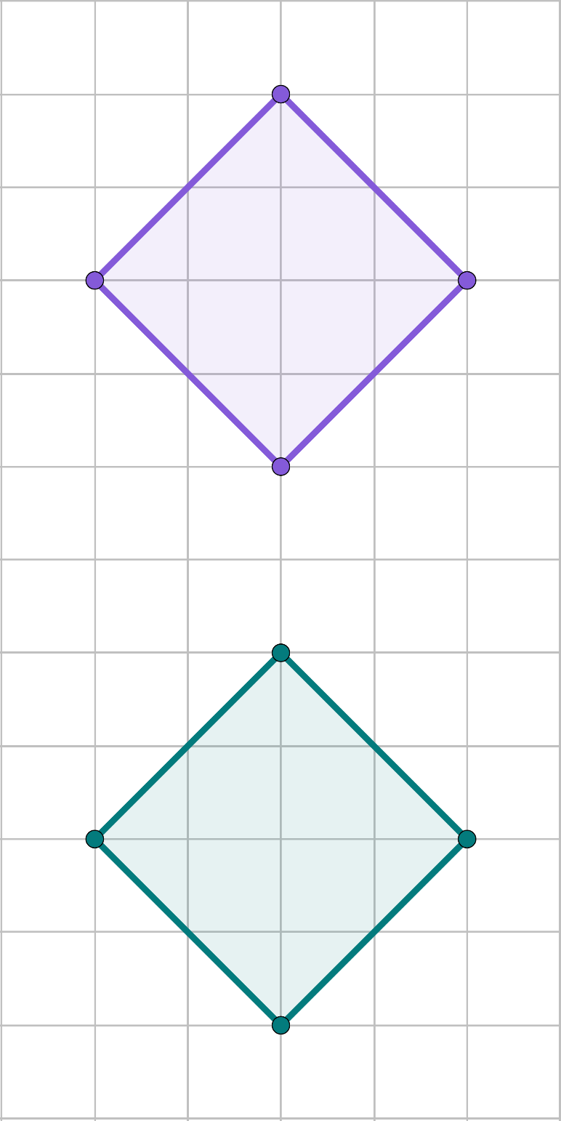
Which transformation?
Add the labels to the images vertices.
After a vertical reflection
After a translation
After a 180° rotation
D
D
D
A
C
A
C
A
C
B
B
B

Slide 27
Which transformation?
By considering the changes, decide which transformation could have taken place in each case. There might be more than one.
the lengths have changed
the sense has changed
the orientation has changed
the position has changed
enlargement
reflection
reflection or rotation
all

Slide 28
Which transformation?
By considering the invariant properties, decide which transformation could not have taken place in each case. There might be more than one.
the lengths are invariant
the sense is invariant
the orientation is invariant
the angles are invariant
not an enlargement
not a reflection
neither reflection nor rotation
none (since all 4 transformations you are familiar with have invariant angles!)

Slide 29
Which transformation?
Identify the type of transformation that has taken place to create the new shape.
a)
b)
c)
reflection
rotation
rotation
d)
e)
f)
reflection
reflection
rotation

Slide 30
Which transformation?
Add the image vertices labels.
After a vertical reflection
After a translation
After a 180° rotation
D
D
D
A
C
A
C
A
C
B
B
B
B′
D′
B′
A′
C′
A′
C′
C′
A′
D′
B′
D′

Slide 31
Transformed objects
Which transformation?
Recognising and describing transformations

Slide 32
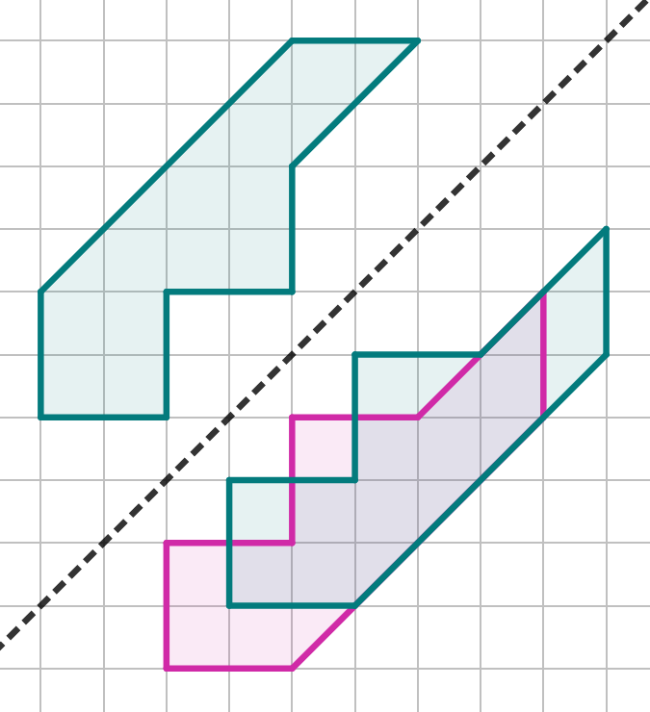
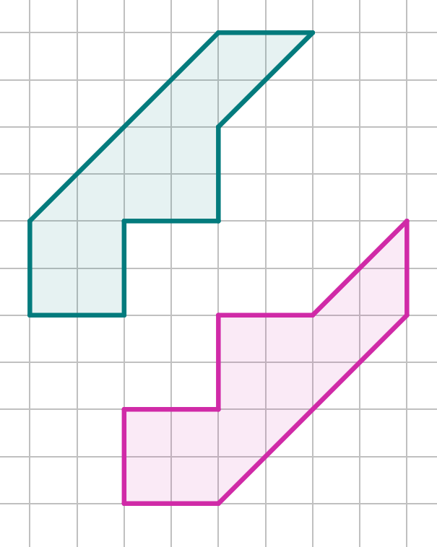

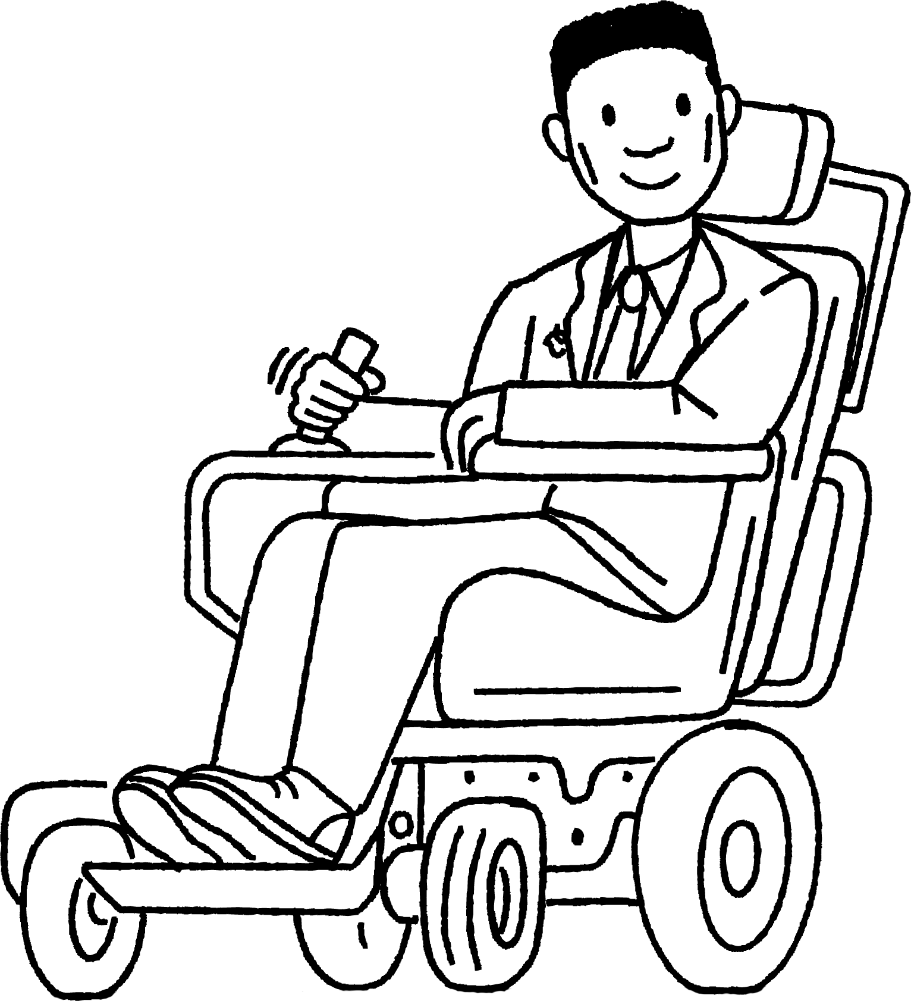
Recognising and describing transformations
The sense has changed,
the position has changed,
the orientation has changed,
the lengths and angles are invariant.
It must be a reflection.

Slide 33
Recognising and describing transformations
Knowing the properties have changed or are invariant only gives you an indication of the type of transformation that might have taken place.
The position of the image is important too.

Slide 34
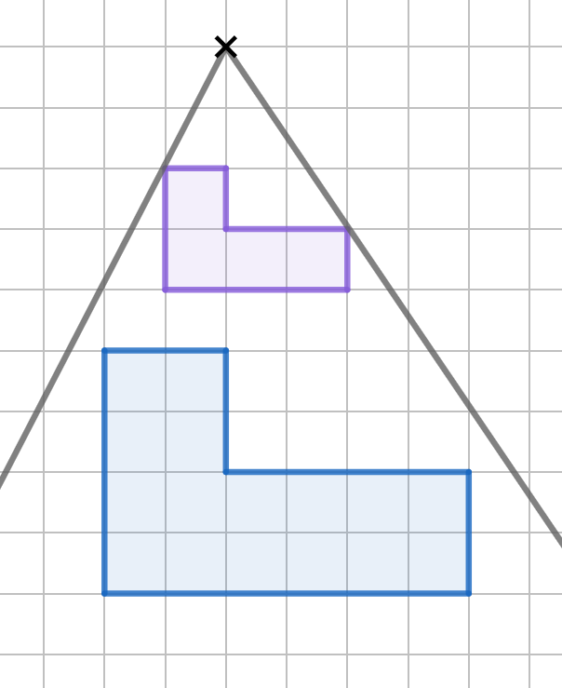
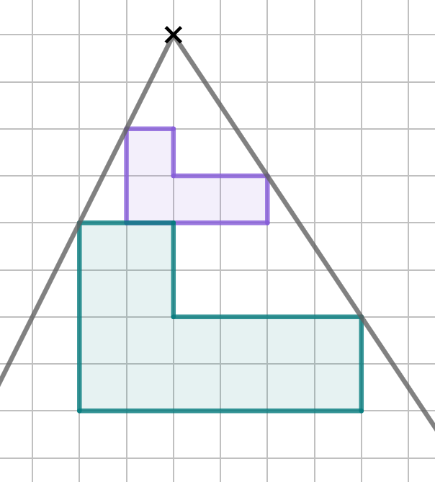
Recognising and describing transformations
Enlargement from a set point
Invariant properties:
angles
sense
orientation
Changed properties:
position
lengths
object
object
image
image

Slide 35
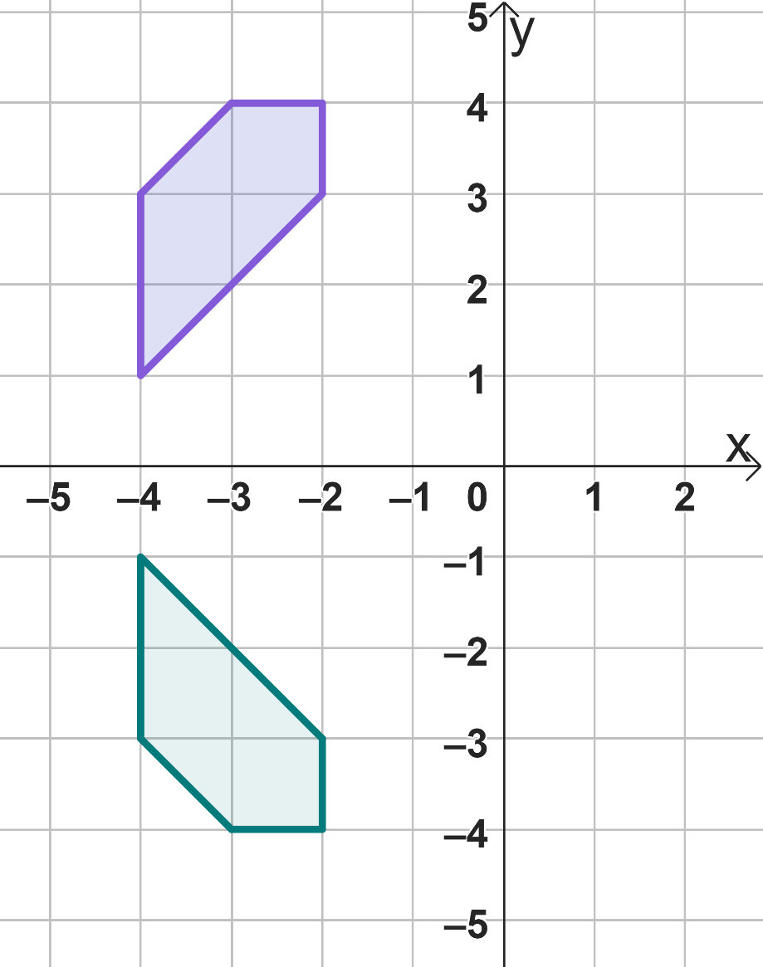

Recognising and describing transformations
The orientation, position and sense have changed. It is a reflection.
The object has been reflected in the x -axis.

Slide 36
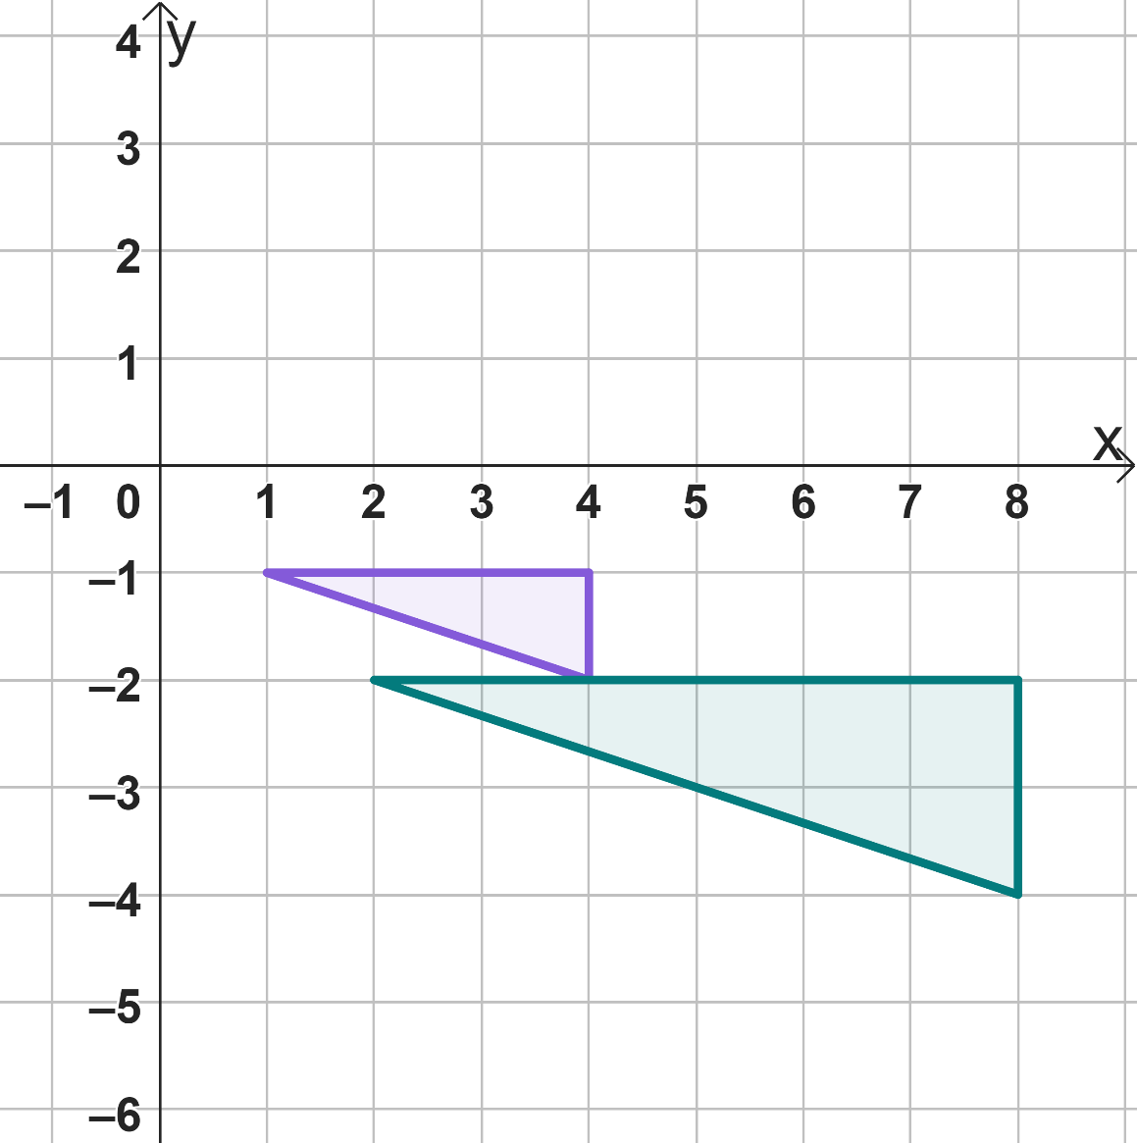
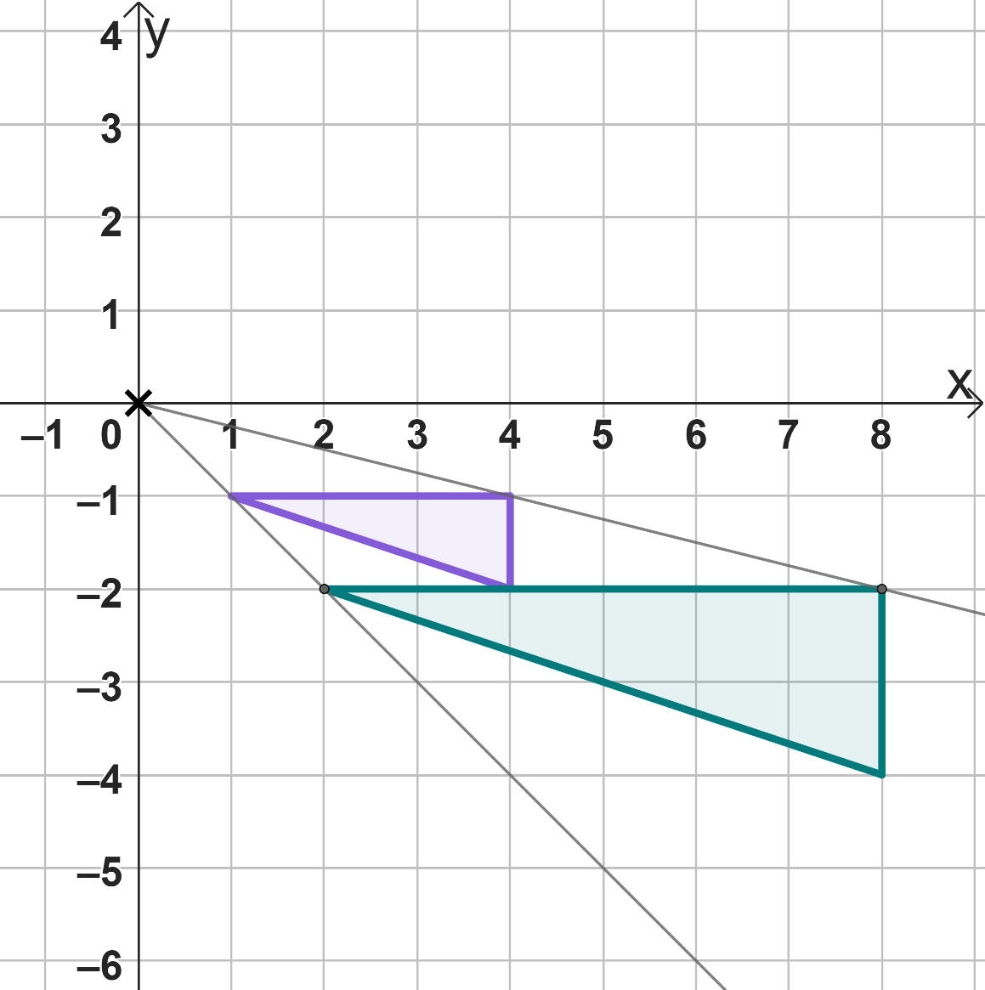
Recognising and describing transformations
The position and lengths have changed. It has been enlarged.
The object has been enlarged by a scale factor of 2 from the origin.

Slide 37
Recognising and describing transformations
What information do you require in the description of a rotation?
Centre of rotation and direction of turn
Centre of rotation, direction of turn and amount of turn
Centre of rotation and amount of turn

Slide 38
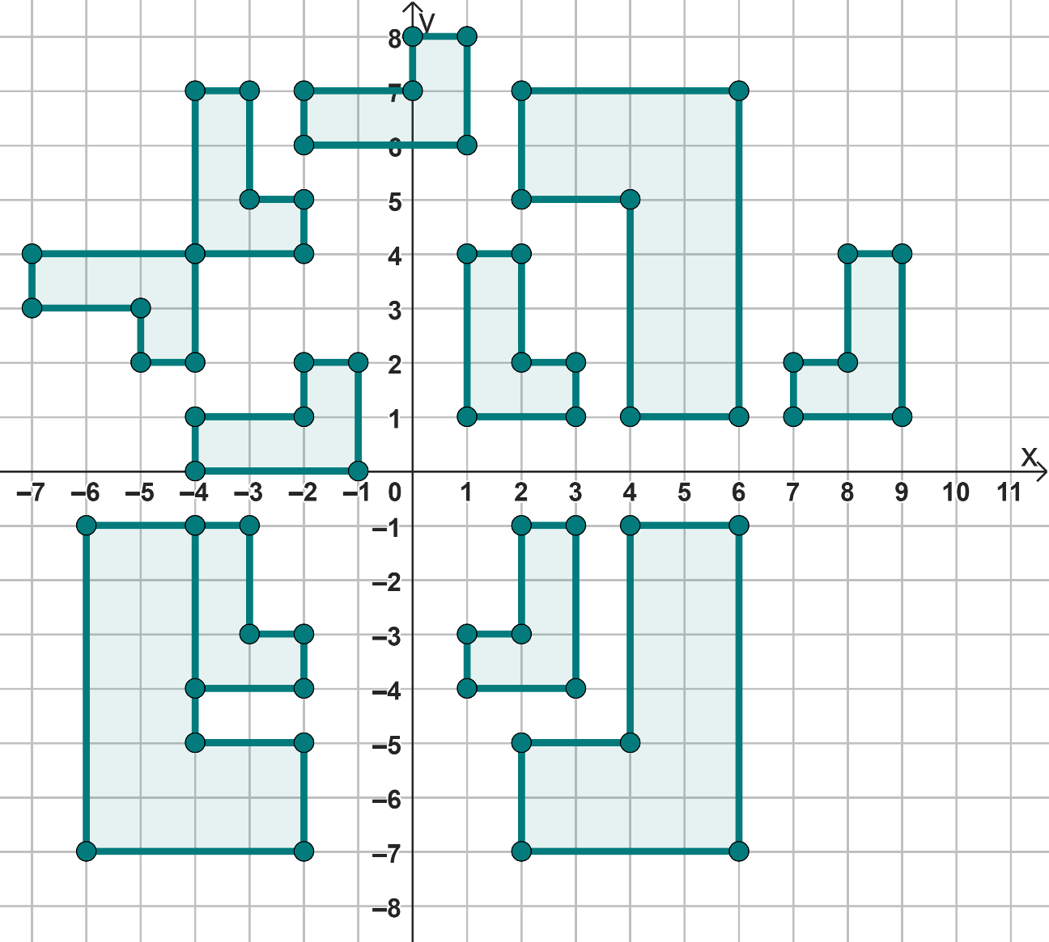
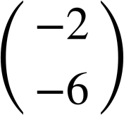
Recognising and describing transformations
Complete the descriptions.
B
A
C
Shape A has been reflected in a diagonal line passing through (-3, 3) and (1, -1) onto shape .
Shape has been reflected in the y-axis onto shape .
Shape has translated by
onto shape .
D
F
G
E
H
I
J
K

Slide 39

Recognising and describing transformations
Complete the descriptions.
B
A
C
Shape has been enlarged by scale factor 2 from (-2, -1) onto shape .
Shape has translated by __ onto shape A.
Shape has been rotated 180° about the origin onto shape .
D
F
G
E
H
I
J
K

Slide 40
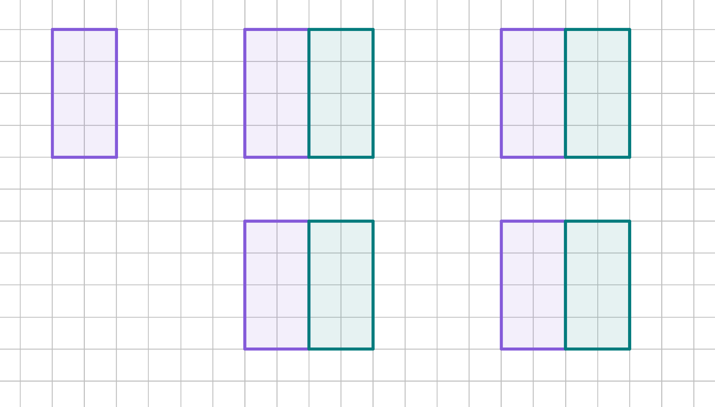
Recognising and describing transformations
Three different transformations have taken place to create an image, which combined with the object forms a square.
What are they? Describe each fully.

Slide 41
Recognising and describing transformations
Complete the descriptions.
B
A
C
Shape A has been reflected in a diagonal line passing through (-3, 3) and (1, -1) onto shape D.
Shape J has been reflected in the y-axis onto shape K.
Shape B has translated by
onto shape E.
D
F
G
E
H
I
J
K

Slide 42

Recognising and describing transformations
Complete the descriptions.
B
A
C
Shape H has been enlarged by scale factor 2 from (-2, -1) onto shape J.
Shape H has translated by __ onto shape A.
Shape C has been rotated 180° about the origin onto shape J.
D
F
G
E
H
I
J
K

Slide 43

Recognising and describing transformations
Three different transformations have taken place to create the image, which combined makes a square.
What are they?
1) Translate by
2) Reflect along the right edge of the shape.
3) Rotate 180° around the midpoint of the right edge.

Slide 44
Transformed objects
When identifying the type of transformation that may have occurred, it is important to consider the properties of the image compared to the object.
If the lengths have changed, then an enlargement may have taken place.
If the sense has changed, then a reflection may have taken place.
If the orientation has changed, then a rotation may have taken place.
If the position has changed, then a translation may have taken place.

Slide 45

© Oak National Academy 2023.
Produced in partnership with Mathematics in Education and Industry.
Licensed on the Open Government Licence v3.0, except where otherwise stated. See Oak terms and conditions.

